Slide 1

Obesity in America
Members: Jason
Ketal
Sivakumar
Jose

Slide 2
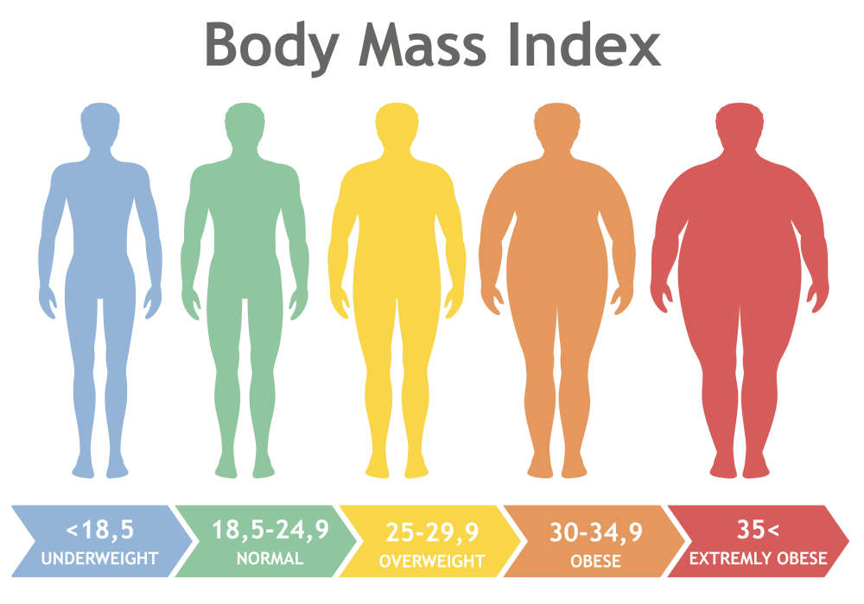
Introduction
Obesity % varies across ethnicity, age, sex, income, education?

Slide 3





Tools
https://github.com/Toomuchdata2018/ObesityProject

Slide 4
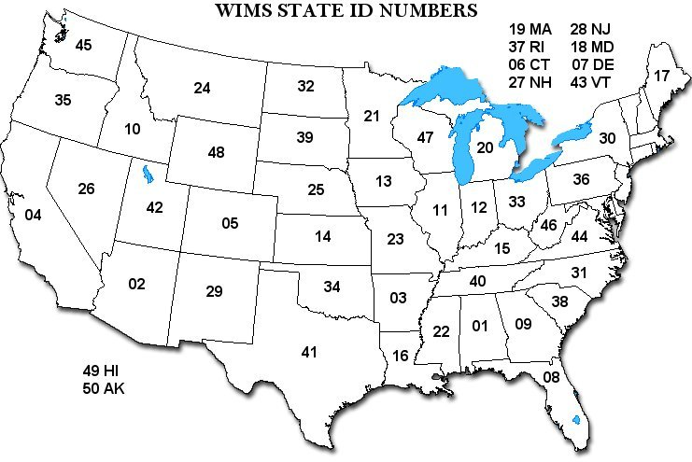



Data Sources
Fips State Codes
https://www.cdc.gov/brfss/brfssprevalence/index.html
folium

Slide 5
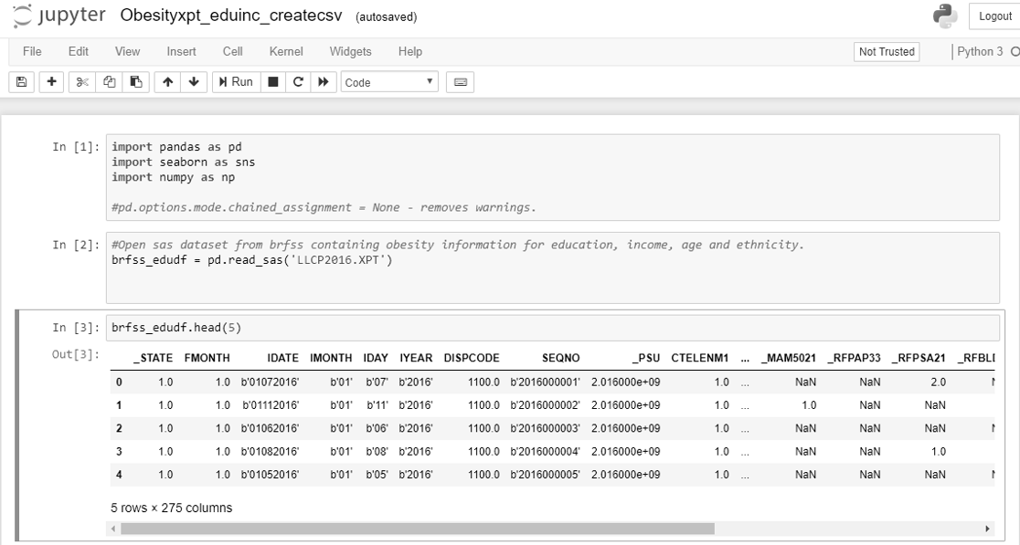
Data Source details

Slide 6
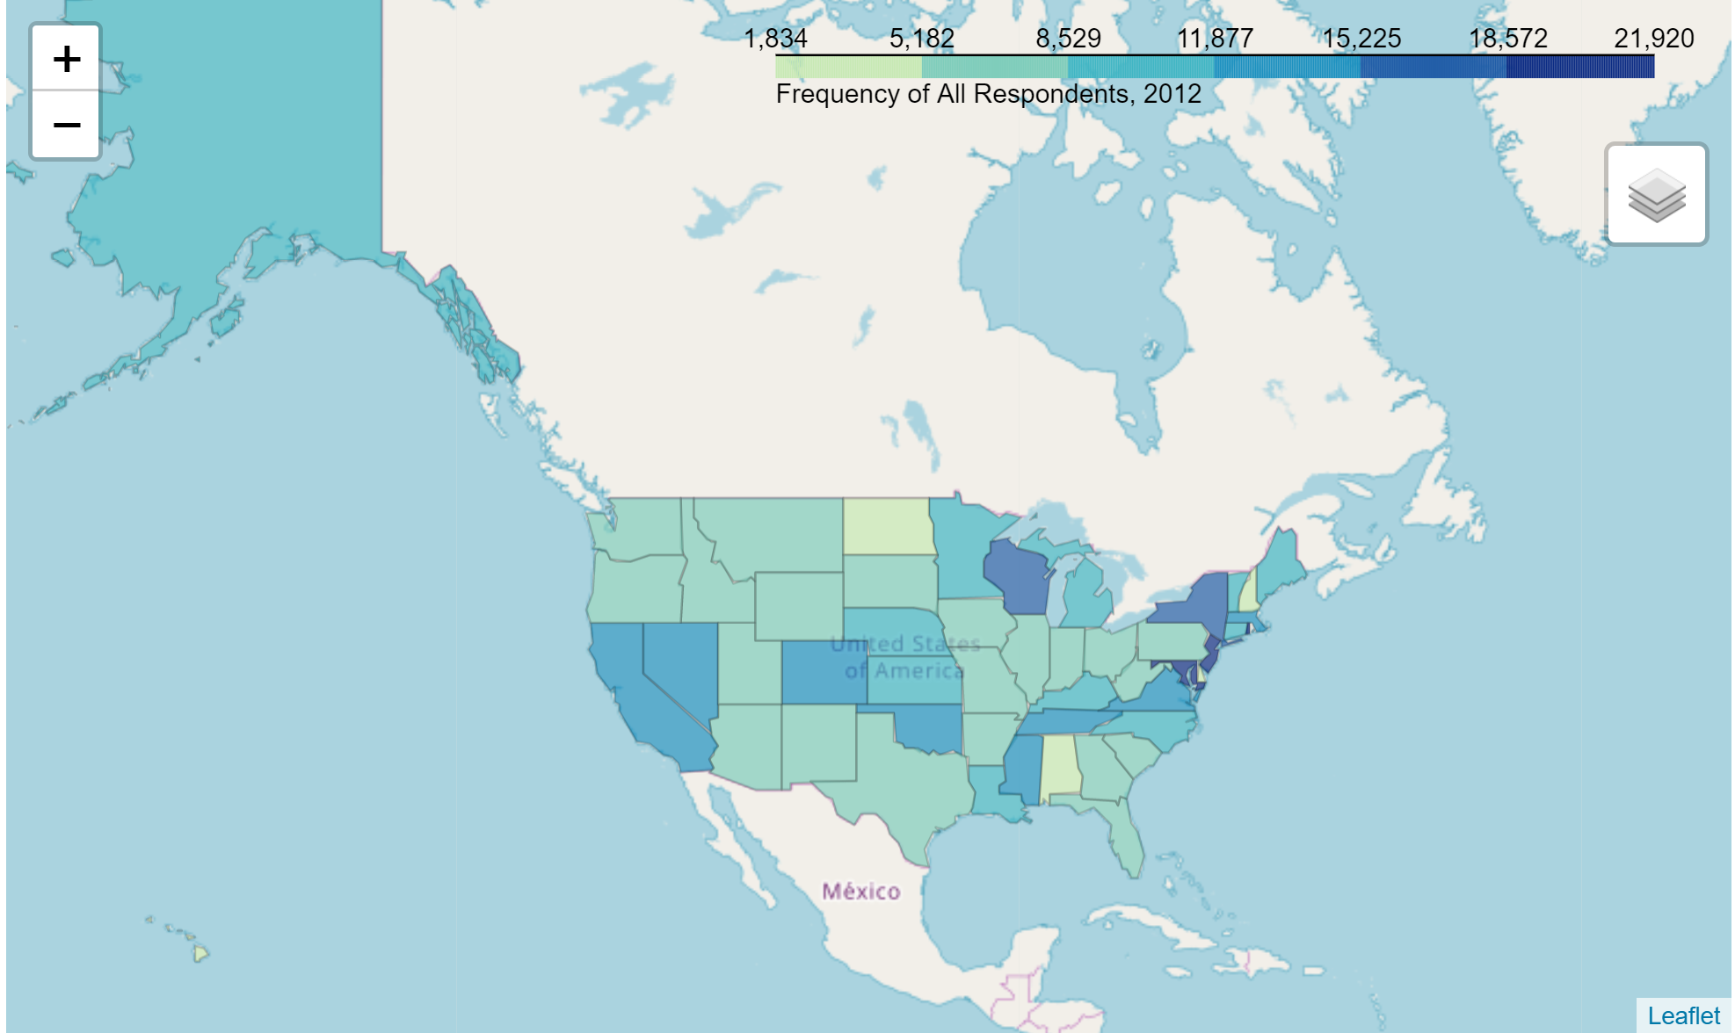
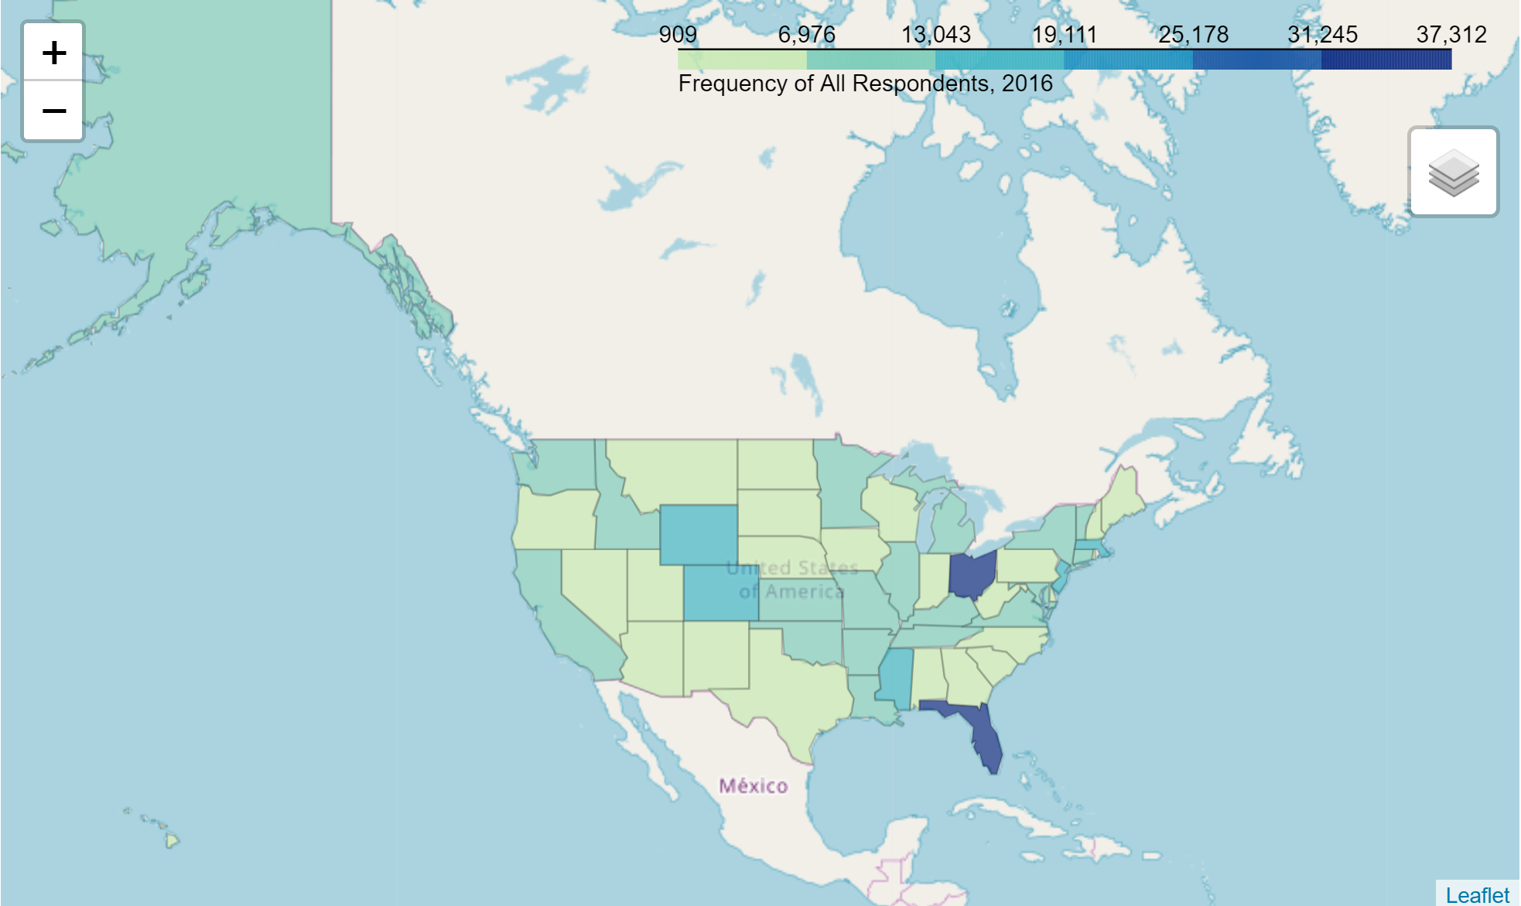
Beginnings
First fast food restaurants vs obesity
CDC Division of Nutrition, Physical Activity, and Obesity (DNPAO) / BRFSS Study
CDC Behavioral Risk Factor Surveillance System (BRFSS) Raw Data

Slide 7
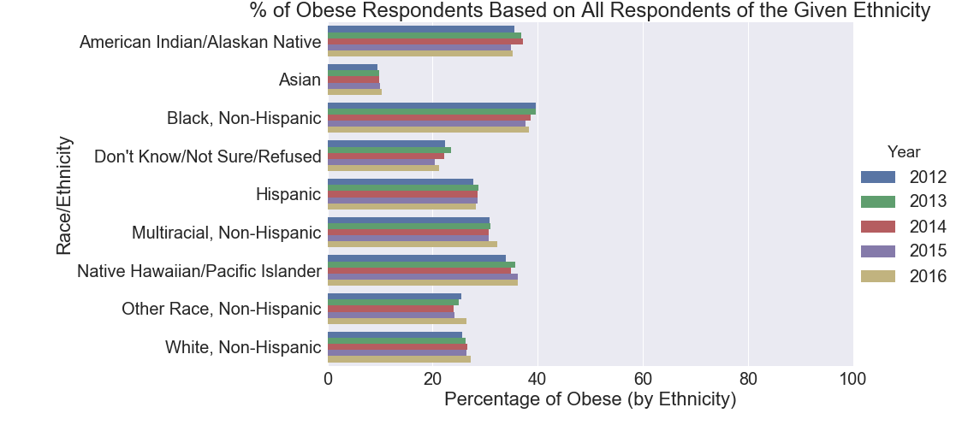
Ethnicity and Obesity

Slide 8
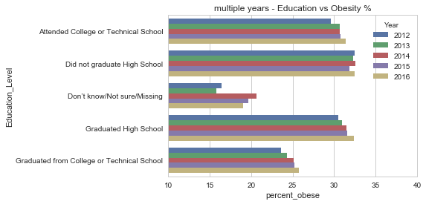
Education and Obesity

Slide 9
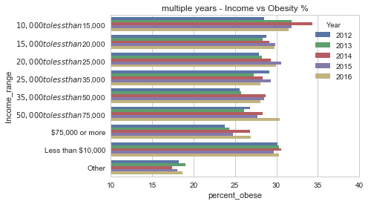
Income and Obesity

Slide 10
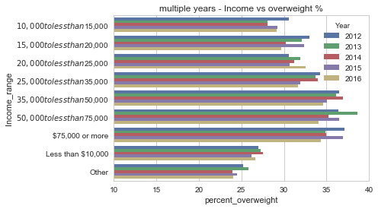
Income and Overweight

Slide 11
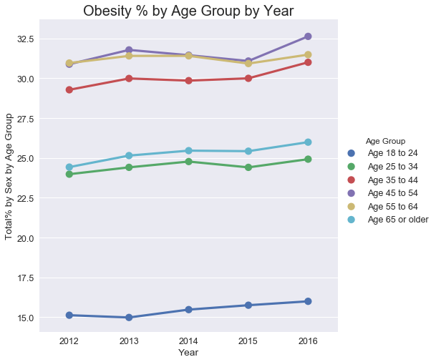
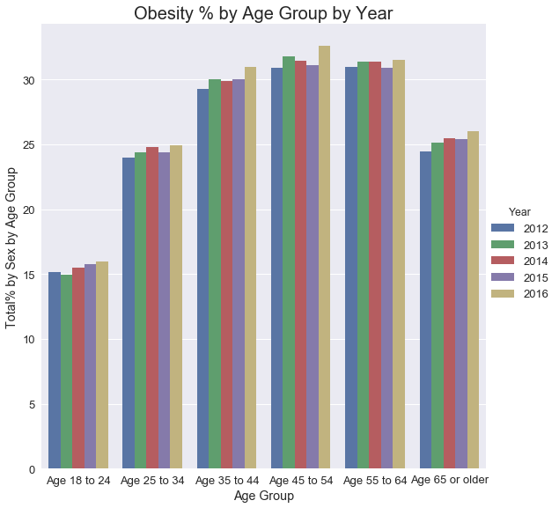
Age and Obesity

Slide 12
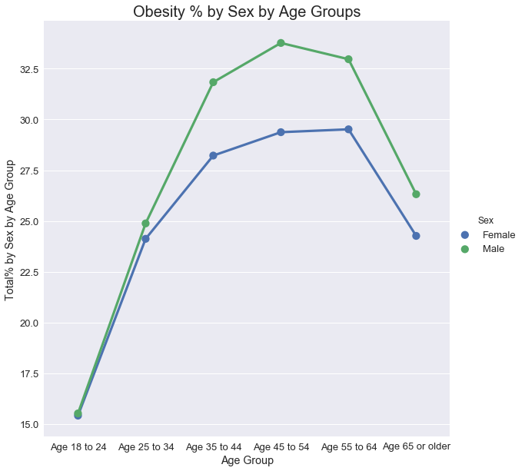
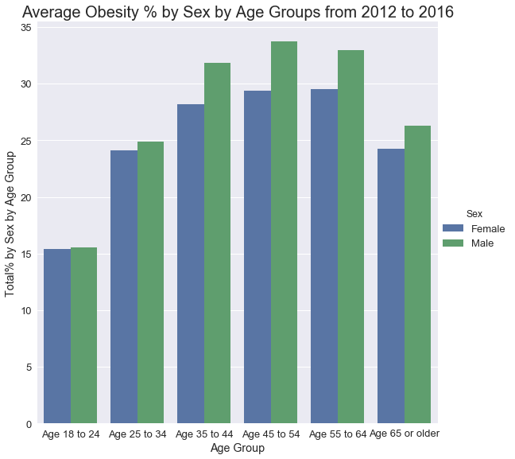
Age and Sex

Slide 13
Data Munging
Go to Jupyter!

Slide 14
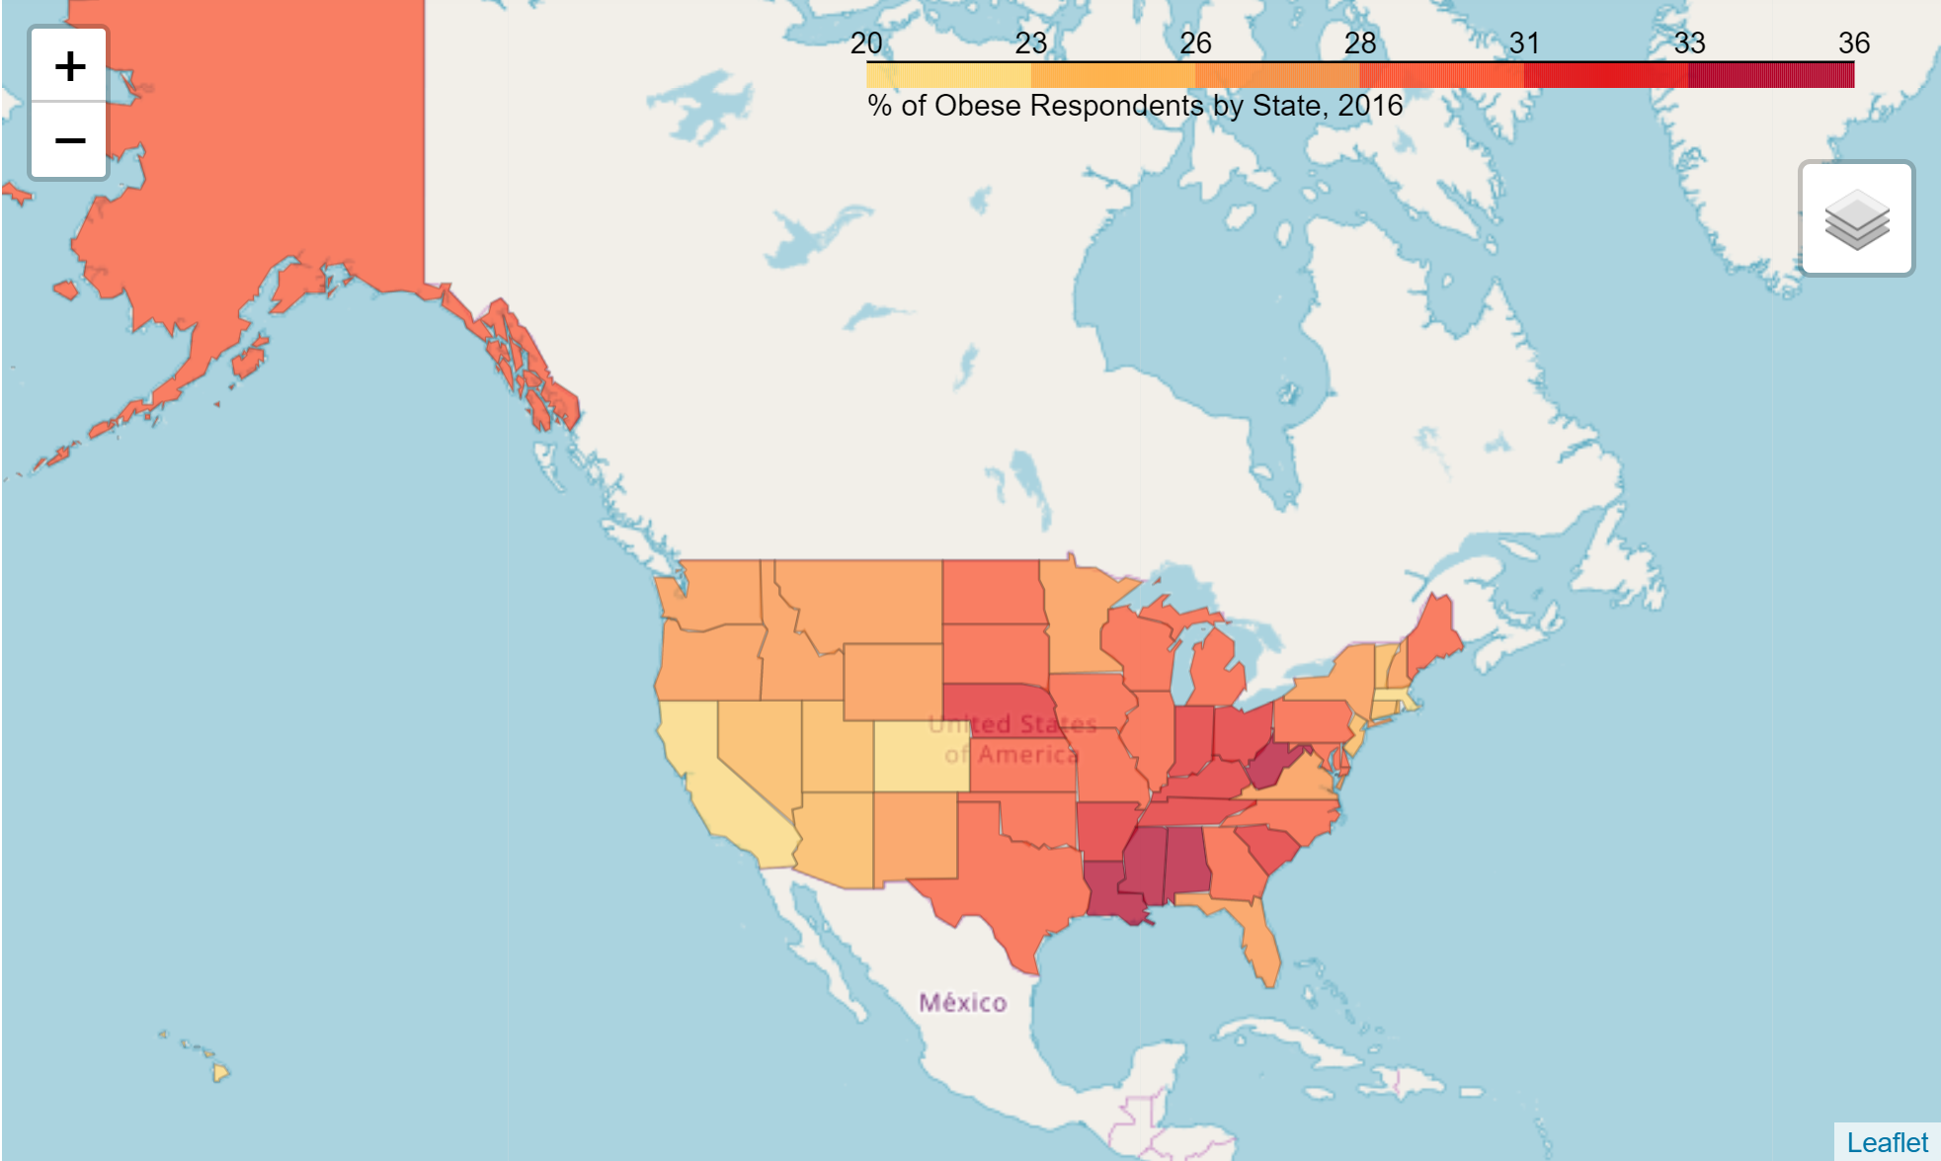
Going Forward…

Slide 15
Questions?

